Slide 1













MEDIA KIT
On Air – On Line – On Target
INTEGRATED MARKETING

Slide 2



Black Diamond Broadcasting believes in providing marketing solutions by utilizing the traditional broadcasting of our elite radio stations, and integrating digital and social media platforms, streaming audio on line, and incorporating creative promotions and events.
Integrated Media!
ENGAGING AUDIENCES THROUGH PROVEN AND NEW MEDIUMS UTILIZING AUDIO & VISUAL CONTENT.

Slide 3
Locally owned, locally operated!
Black Diamond Broadcasting
is a Michigan broadcast company.
We work with local, regional, and national businesses, to create effective on-air advertising campaigns with customized on-air radio commercial messages, which are also presented to our listening audience through on-line streaming. In addition, we engage active consumers through our digital and social media platforms. Our unique consulting approach, coupled with choice products, is what delivers the return on your investment.
Black Diamond Broadcasting will help you achieve results through our enormous geographical reach and the individual choices of our top ranked stations.
Right Radio Stations + Right Strategy + Right Message
= Successful Radio Campaign.
TRAVERSE CITY OFFICE
PO Box 6016
Traverse City, MI 49696
(231) 922-4981
PRUDENVILLE/HOUGHTON LAKE OFFICE
818 W Houghton Lake Blvd.
Prudenville, MI 48651
(989) 366-5364
MT. PLEASANT OFFICE
5847 Venture Way
Mt. Pleasant, MI 48858
Office: 989-772-4173
CHEBOYGAN OFFICE
1356 Mackinaw Ave.
Cheboygan, MI 49721
(231) 627-2341
MIDLAND OFFICE
Inside the Midland Mall
6800 Eastman Ave., Suite E564
Midland, MI 48462
(989) 631-1490

Slide 4
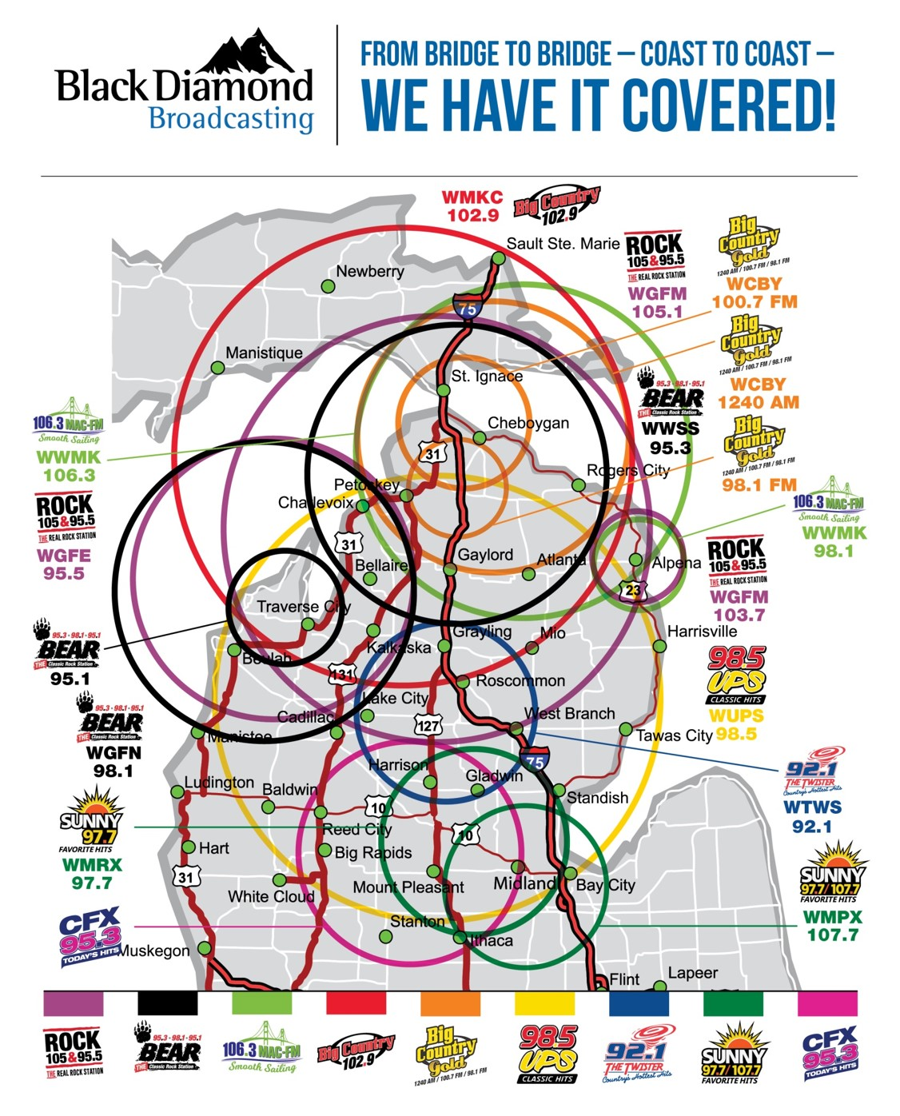

Slide 5









Black Diamond Broadcasting Radio Stations are operated as major market stations, yet they are owned and operated locally in Michigan. We provide big personalities, top ranked station, exciting promotions, and world class technology which delivers advertising results.
Call letters, station name ,frequencies, signal coverage and web sites:
WGFM 105.1 ( & 103.7 Alpena) Mainstream Rock (Market Exclusive Format) 100% SIMULCAST WITH 95.5
Counties Included in WGFM Coverage Area: Alpena: Antrim; Charlevoix; Cheboygan; Crawford: Emmet; Grand Traverse: Kalkaska: Leelanau: Mackinac; Missaukee; Montmorency: Oscoda: Otsego: Presque Isle; Roscommon and on line at www.rock105.fm
WGFE 95.5 Mainstream Rock (Market Exclusive Format) 100% SIMULCAST WITH 105.1
Counties Included in WGFE Coverage Area: Antrim; Benzie; Charlevoix; Grand Traverse: Kalkaska: Leelanau: Manistee ; Wexford and on line at www.rock105.fm
WGFN 98.1 Classic Rock the Bear 100% SIMULCAST WITH 95.3 Counties Included in Coverage Area: Antrim; Benzie; Charlevoix; Grand Traverse: Kalkaska: Leelanau: Manistee, Missaukee; Wexford and on line at www.classicrockthebear.com
95.1 (translator) Classic Rock the Bear 100% SIMULCAST WITH 98.1/95.3 Counties Included in Coverage Area: Concentrated coverage of Traverse City proper in Grand Traverse Co.
WWSS 95.3 Classic Rock the Bear 100% SIMULCAST WITH 98.1 Counties Included Coverage Area: Antrim; Charlevoix; Cheboygan; Chippewa; Emmet; Mackinac; Montmorency; Otsego; Presque Isle and on line at www.classicrockthebear.com
WMKC Big Country 102.9 (Hit Country) Counties Included in Coverage Area: Antrim; Charlevoix; Cheboygan; Chippewa; Crawford: Emmet; Grand Traverse: Kalkaska: Leelanau: Mackinac; Montmorency: Otsego: Presque Isle and on line at www.1029bigcountry.com
WCBY AM 1240/100.7 & 98.1 FM 100% SIMULCAST Big Country Gold Classic Country- Counties Included in Coverage Area: Cheboygan; Chippewa; Emmet; Mackinac; Otsego, Presque Isle and on line at www.bigcountrygold.com
WWMK Smooth Sailing – 106.30MAC FM (Market Exclusive Format) 100% SIMULCAST Counties Included Coverage Area: Alpena; Charlevoix Cheboygan; Chippewa; Emmet; Mackinac; Montmorency; Otsego: Presque Isle and on line at www.1063macfm.com
WUPS 98.5 The Classic Hits Station Counties included in Coverage Area: Alcona ; Antrim; Arenac; Bay; Clare; Crawford; Gladwin; Grand Traverse; Gratiot; Iosco; Isabella; Kalkaska; Lake; Mecosta; Midland; Missaukee; Montcalm; Montmorency; Newago; Ogemaw; Osceola; Oscoda; Otsego Roscommon and on line at www.wups.com .
WTWS 92.1 FM The Twister Counties Included in Coverage Area: Clare; Crawford; Gladwin; Kalkaska; Missaukee; Ogemaw; Osceola; Roscommon on line at www.ilovethetwister.com
WMRX SUNNY 97.7 Counties included in Coverage Area: Arenac; Bay; Clare; Gladwin; Gratiot; Isabella; Mecosta; Midland; Missaukee; Ogemaw; Osceola; Roscommon and on line at www.ssunny977.com .
WMPX – SUNNY 107.7, 1490AM Counties Included in Coverage Area 100% SIMULCAST: Bay, Gratiot, Midland, on line at and on line at www.ssunny977.com .
WCFX – 95.3 Counties included in Coverage Area: Bay; Clare; Gladwin; Gratiot; Isabella; Mecosta; Midland; Missaukee; Osceola; and on line at www.WCFX.com

Slide 6
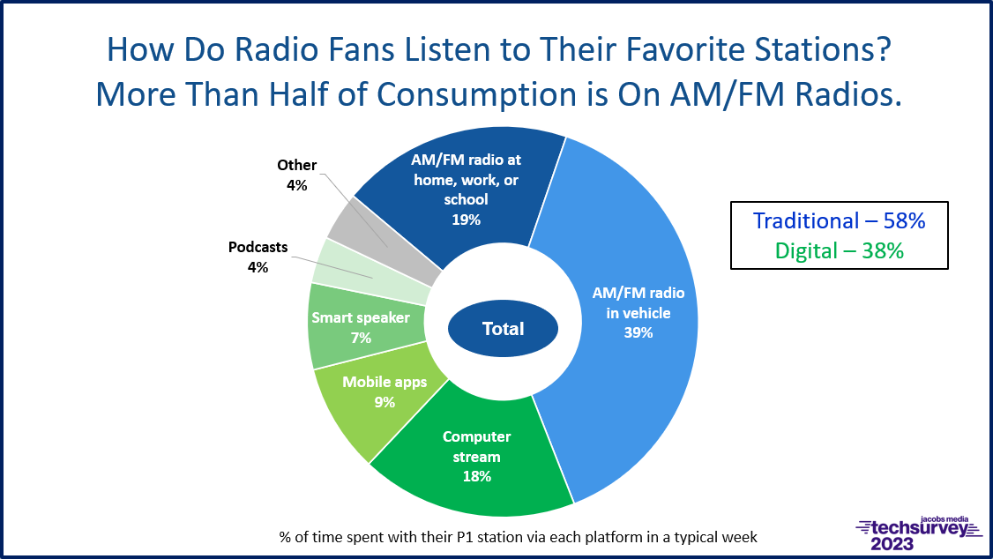
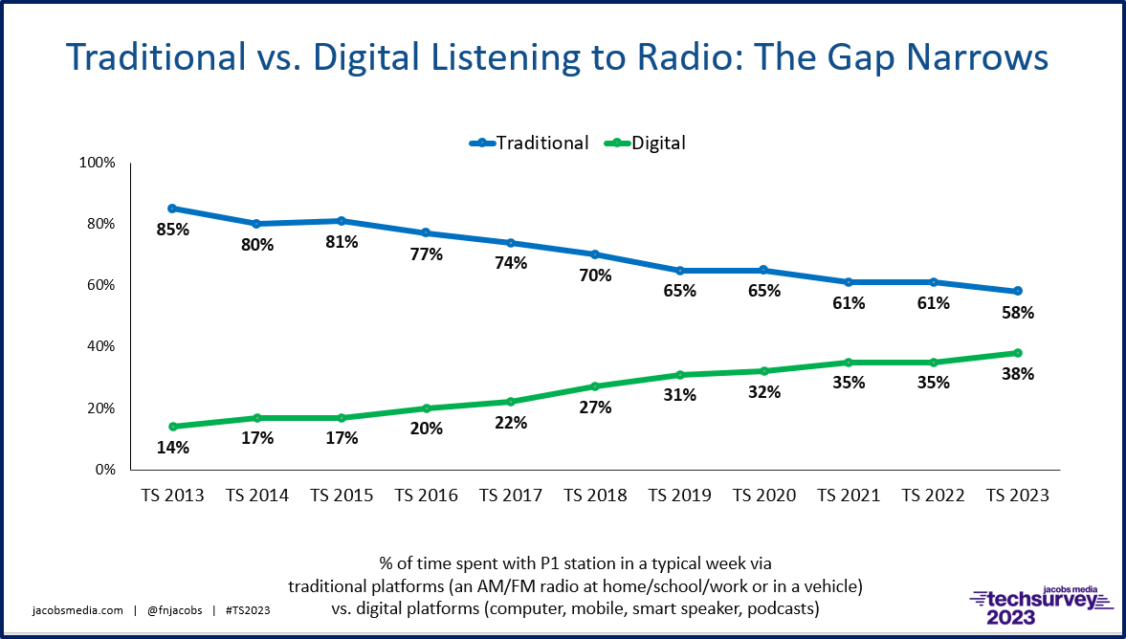

Slide 7


Q1, Q2, Q3 2024
23,888,758 STREAM SESSIONS STARTS!
5% GROWTH OVER EQUAL PERIOD, YEAR PRIOR!
Monthly Stream audience:
Based on Sept. 24 sessions starts:
  WUPS 748,445
  WGFM 421,654
  WMKC 473,594
  WGFN 236,270
  WWMK 331,133
  WCBY 91,653
  WMRX 89,820
  WCFX 67,817
  WTWS 66,421
LOCAL CONTENT,
BY LOCAL INFLUENCERS!

Slide 8

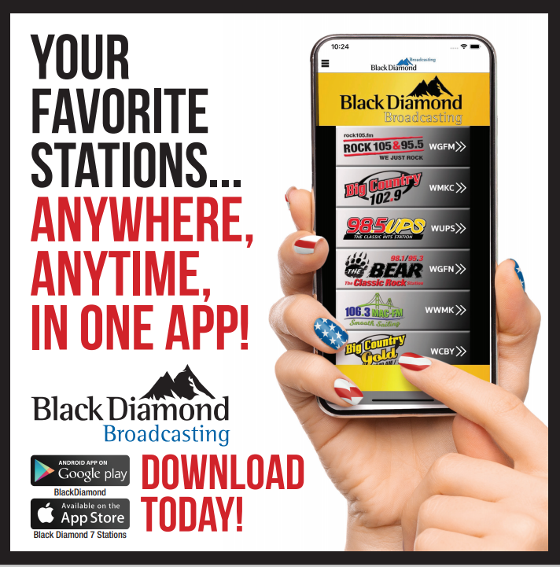
Radio App
WITH 9 STATION BRANDS!

Slide 9




21% INCREASE in event engagements!*
Black Diamond Mobile APP
(9 stations)
JAN 1 – JULY 31, 2024
5947 Unique Users
by I.P. address
1,367,277 Events
WMKC 10,817
WGFM 15,399
WUPS 17,012
WGFN 9,422
WWMK 5,797
WCBY 3,484
WMRX 3,536
WCFX 2,248
WTWS 2,436
The Black Diamond Broadcasting 9-Station Radio App is a great place to display your image!
Over 35% more unique users are using the app for information, songs, titles, artists, contests, events and so much more!
Data used from report pulled for
July 31, 2024 based on FULL app use all station pages.

Slide 10
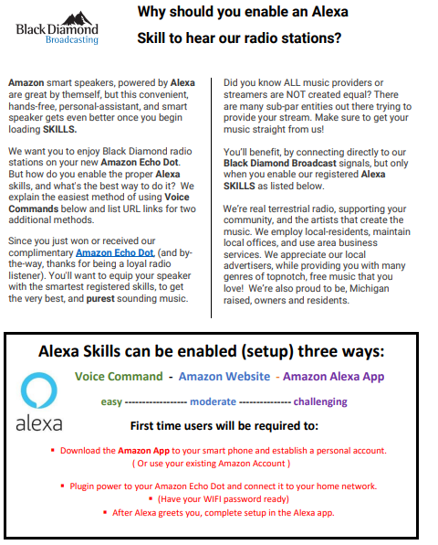

Slide 11




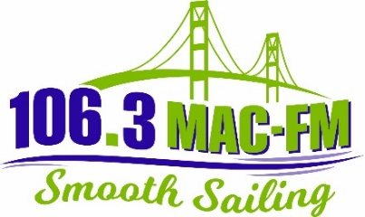

Alpena
Boyne City
Cadillac
Charlevoix
Cheboygan
Gaylord
Indian River
Kingsley
Mackinaw City
Petoskey
Traverse City
St. Ignace
Plus, everywhere in between!
NORTHERN MICHIGAN
Black Diamond Broadcasting Radio Stations are operated as major market stations, yet they are operated locally, serving local these communities;
We provide big personalities, top ranked station, exciting promotions, and world class technology which deliver advertising results.

Slide 12
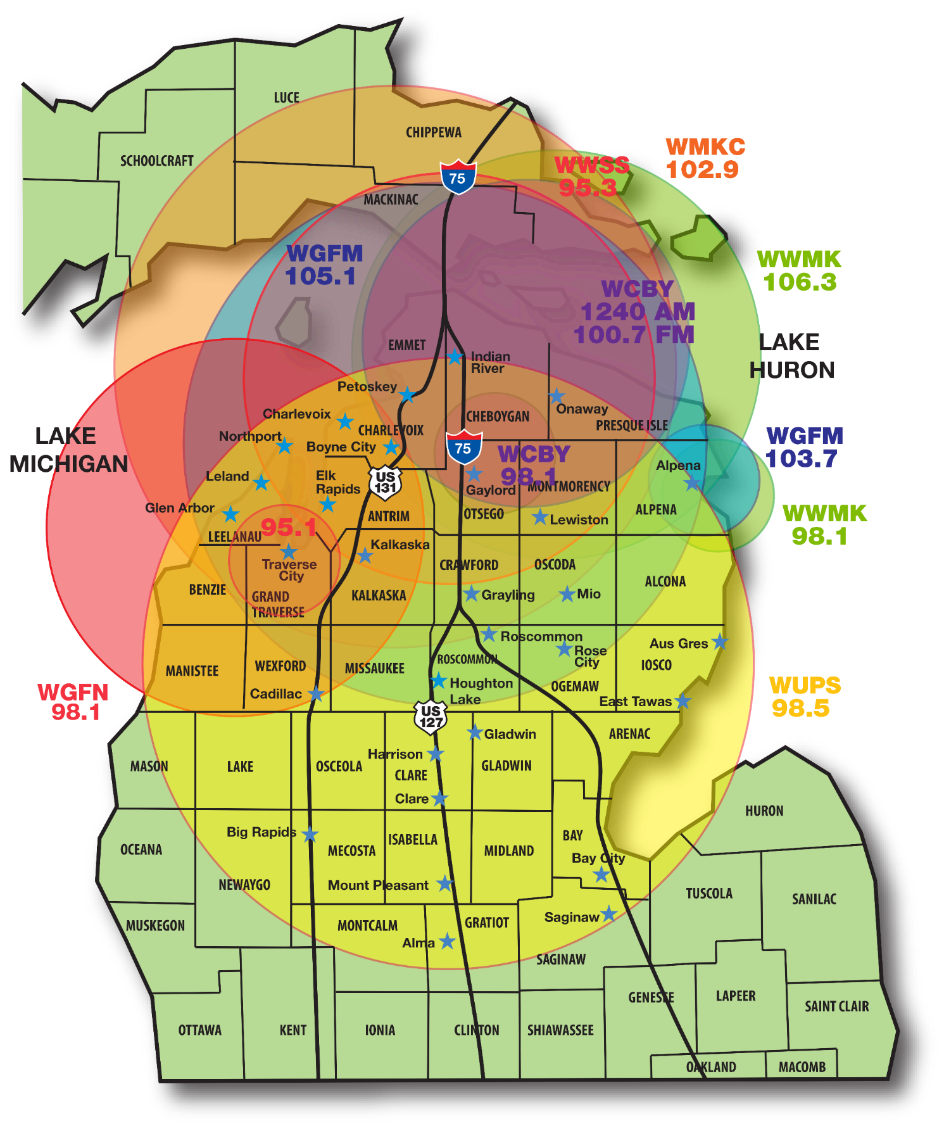

NORTHERN MICHIGAN

Slide 13
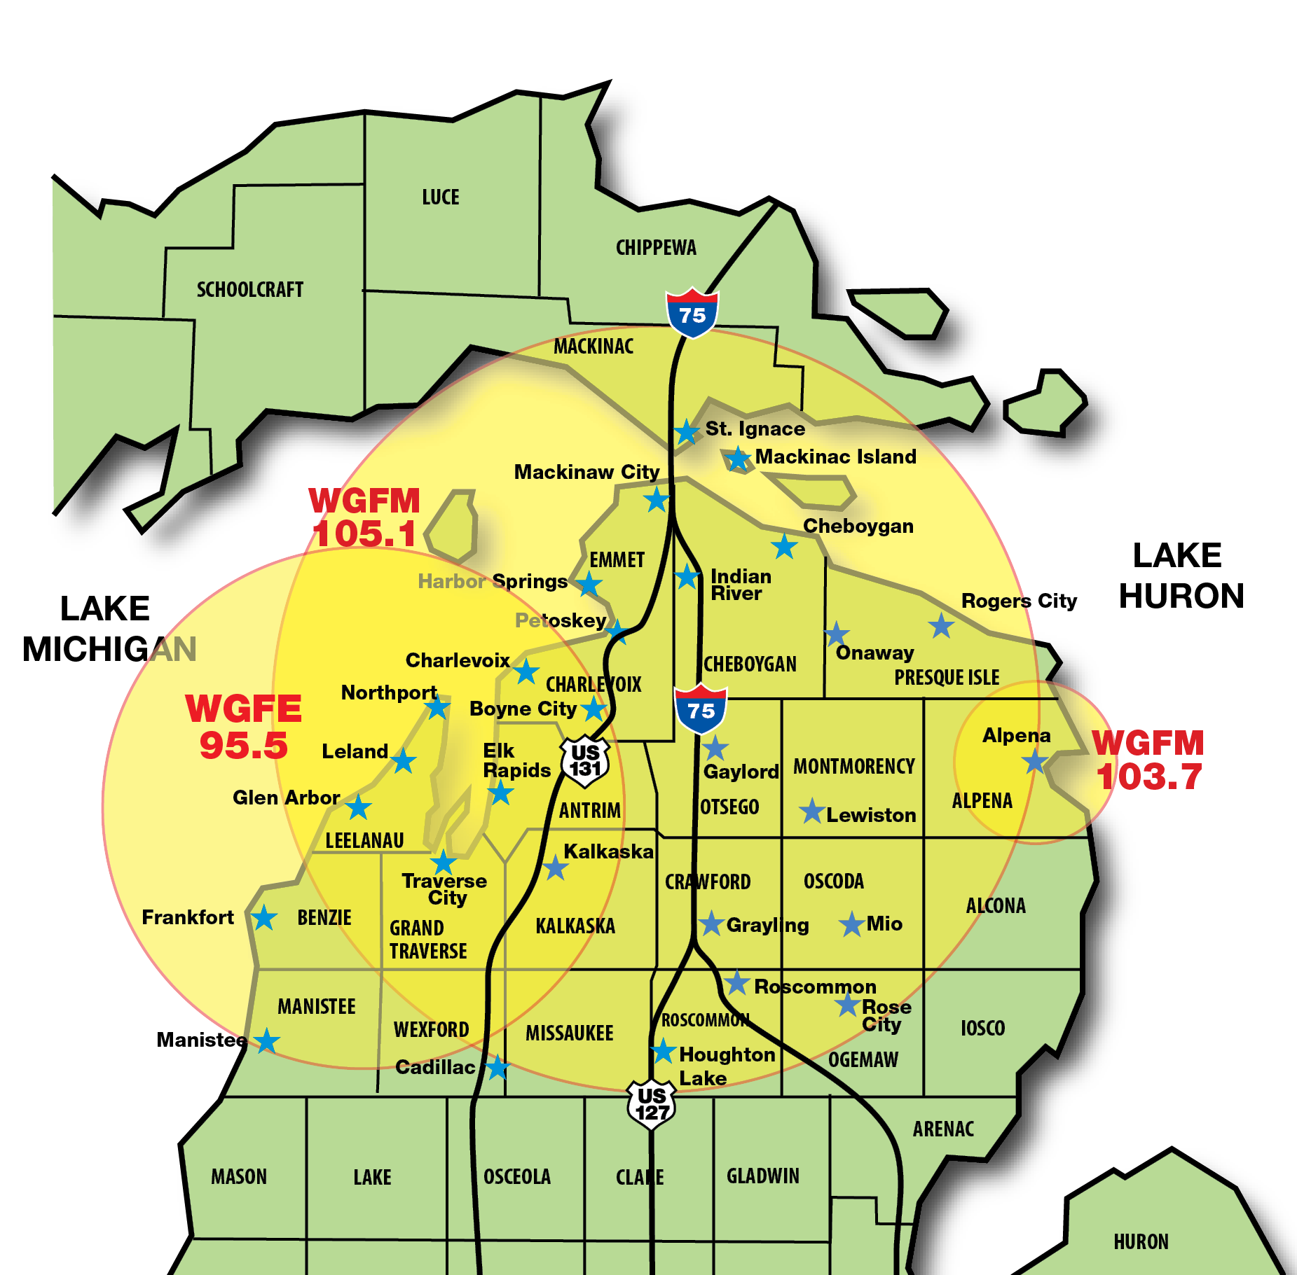

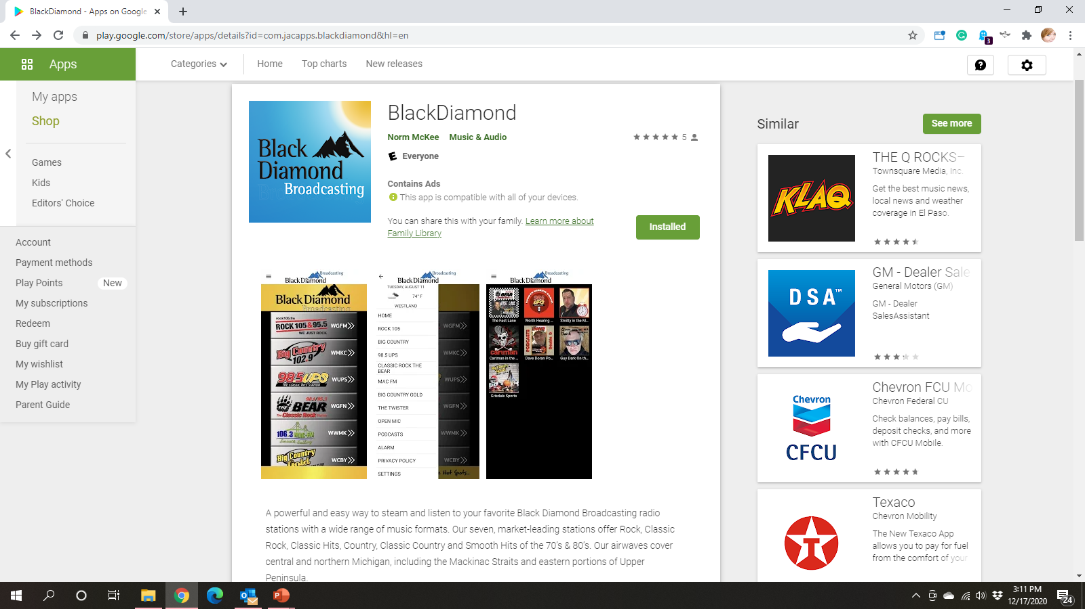



STREAMING ONLINE
www.rock105.fm
GRAND TRAVERSE
REGION
WGFE 95.5
PETOSEKY, GAYLORD, CHARLEVOIX,
STRAITS AREA
WGFM 105.1
ALPENA
WGFM 103.7
ROCK 105/95.5 Targets Adults 18-49
Multi Generation audience appreciate rock anthems from back in the day and new music that’s here to stay
Spending Demo- Consumers that listen are in the “age of acquisition” and are investing in their futures
ROCK 105/95.5 Builds Brand Awareness & Loyalty for your business
Active Lifestyle / Active Consumer
Consumers that listen to ROCK 105/95.5 are engaged in the relevant content between the songs, the on-air personalities plus social media engagement.

Slide 14

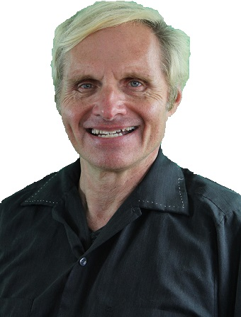
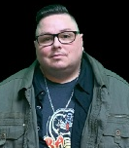
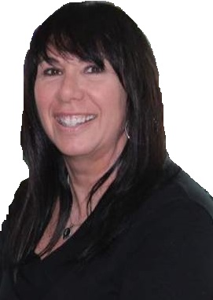
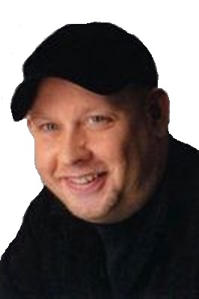







Northern Michigan’s ONLY Mainstream Rock Station
WE’VE GOT PERSONALITY!
CARTMAN
IN THE MORNINGS!
MON-FRI 6A-10A
ANNE CARLINI
MIDDAYS
MON-FRI 10A-3P
DAVE DORAN
A.K.A. DD
MON-FRI 3P-7P
GUY DARK
NIGHTS ON ROCK 105
MON-FRI 7P-MID

Slide 15
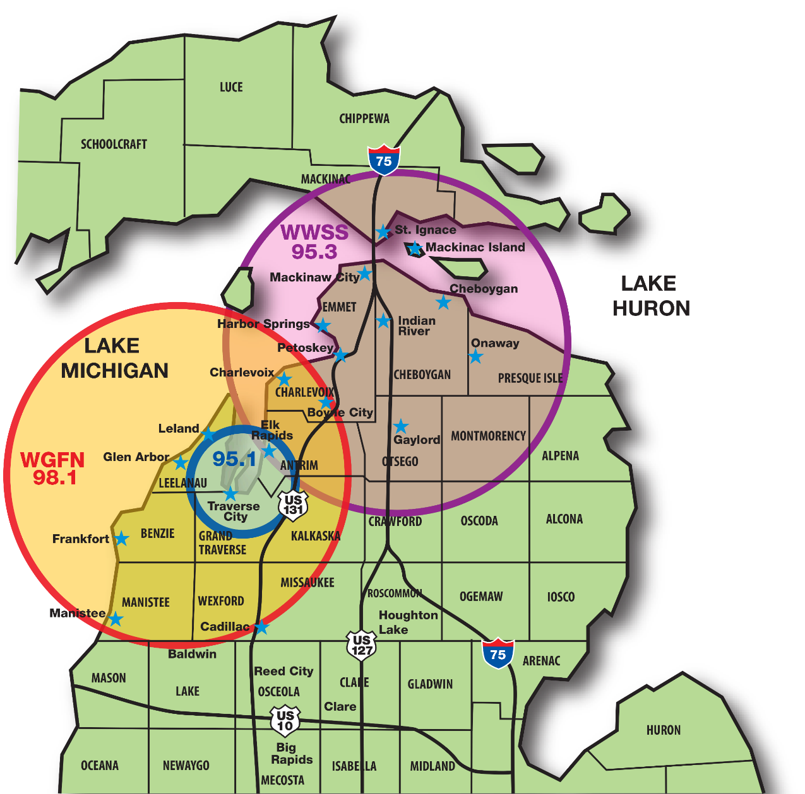




Grand Traverse Area
WGFN
98.1
Straits Area
WWSS
95.3
Translator at 95.1
STREAMING ONLINE
www.classicrockthebear.com
THE BEAR Targets Adults 35-64
Multi-Generations audience appeal of classic rock has never been stronger
Music connects to active consumers as well as established professionals and stable retirees
Consumers listen longer as devout music fans entertained by relevant on-air interaction, fun contests and the Best of Classic Rock

Slide 16


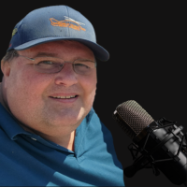

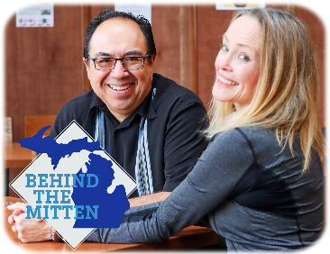






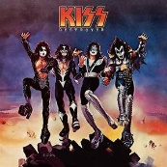


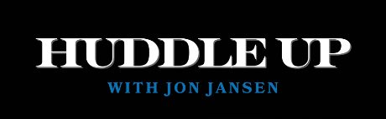
M-F 5A-10A, SAT 6A-10A
The BOB & TOM Show is built on comedy; lifestyle talk and celebrity guests. Add news, sports, the occasional live musical performance and listeners are guaranteed fresh content with 4 hours of upbeat entertainment.
America’s leading media outlet for comedians ranging from superstars like Seth Rogen and Billy Crystal to up-and-coming stars. The BOB & TOM Show is basically like late night TV during your morning drive.
David Barr
Mon – Fri 10a-3p
Guy Dark
Mon – Fri 3p-7p
www.classicrockthebear.com
Weekends Line-up
Sat 10a 3p NASCAR Steve
Sat 7p-10p Sammy Hagar

Slide 17
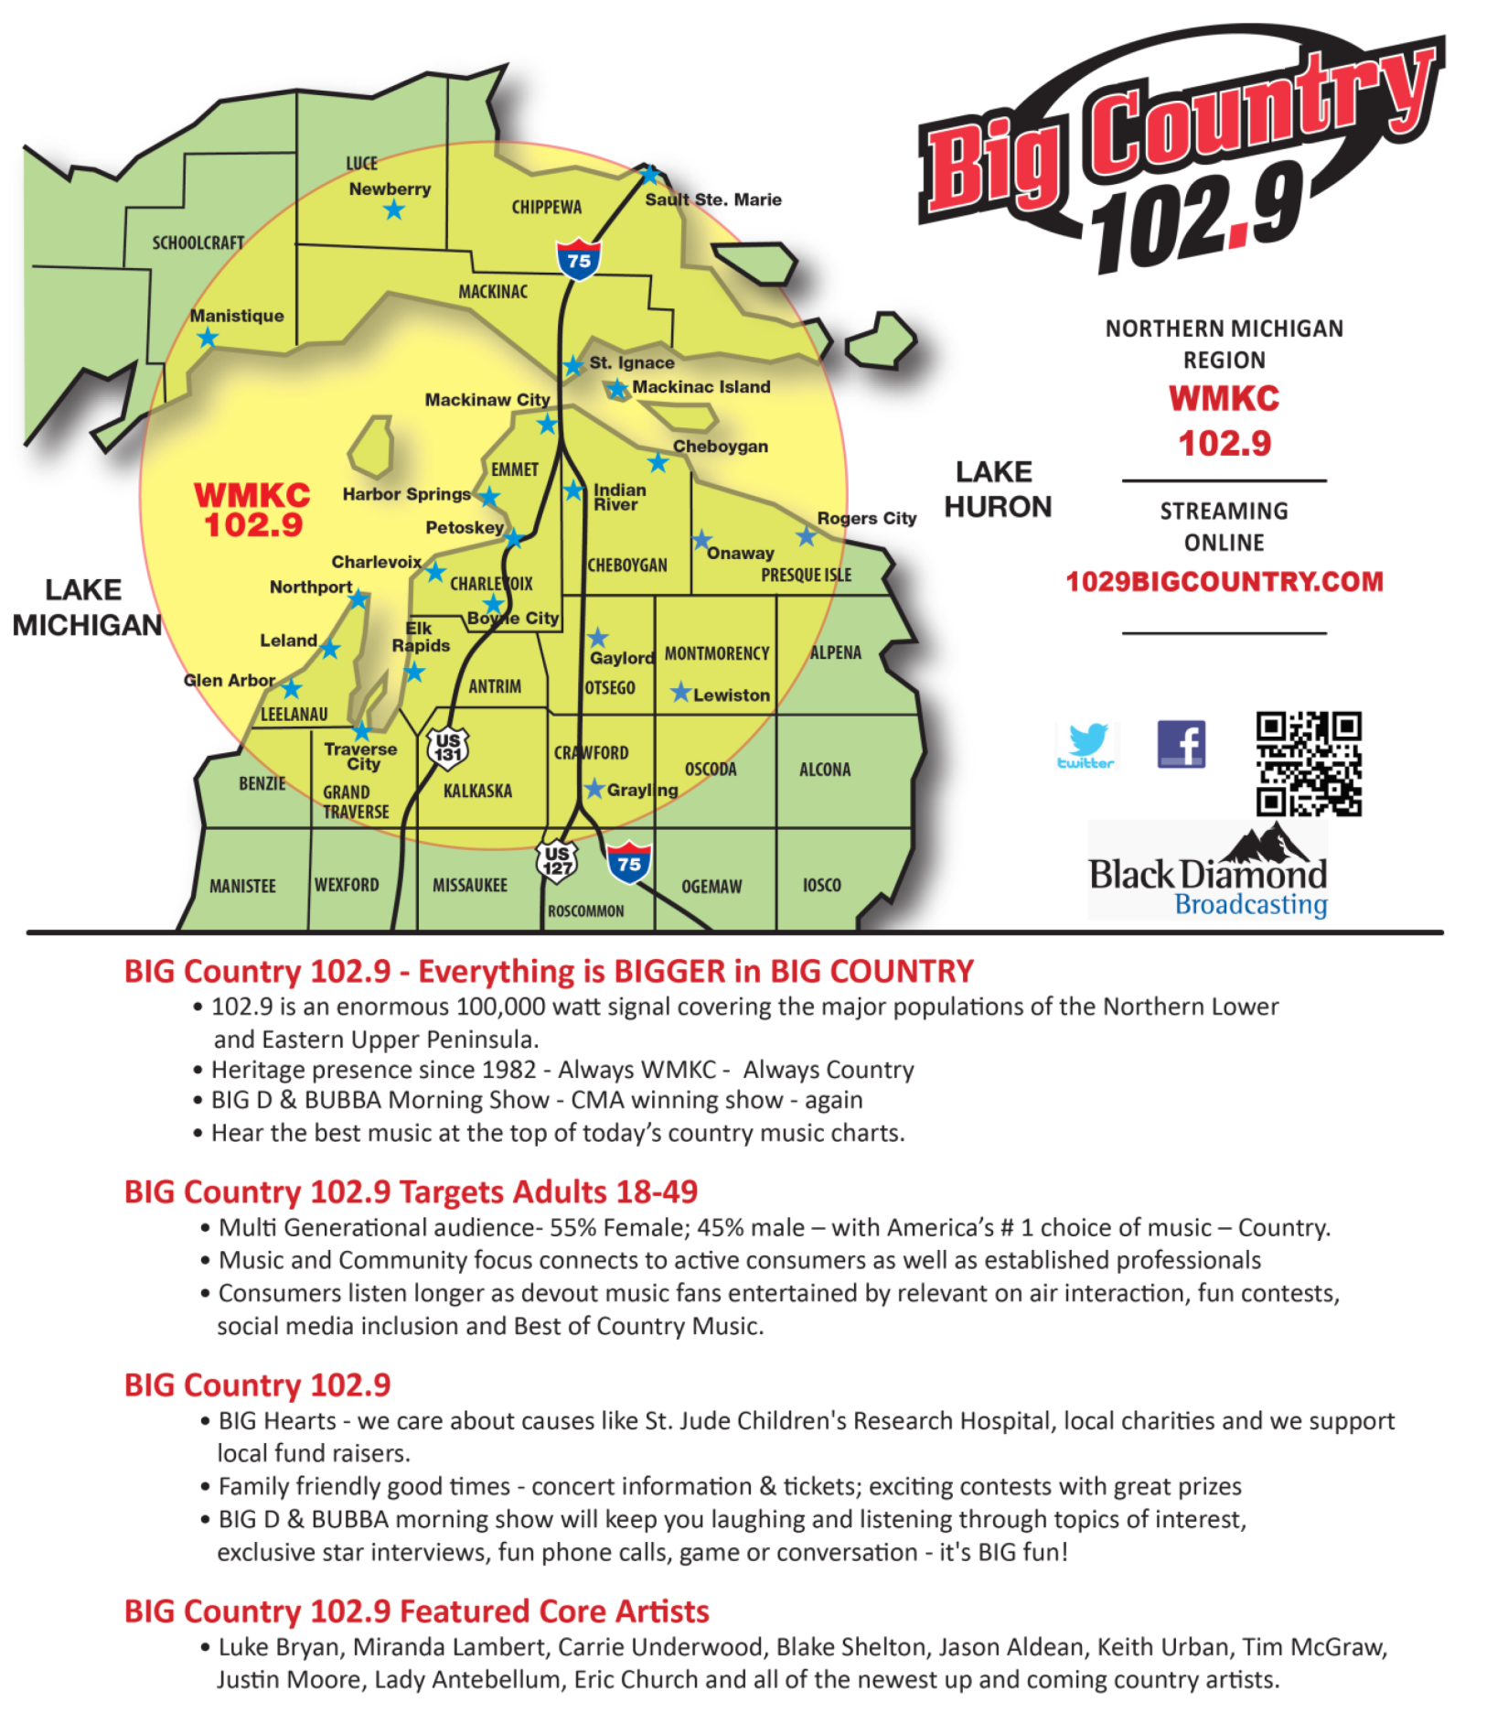

Slide 18
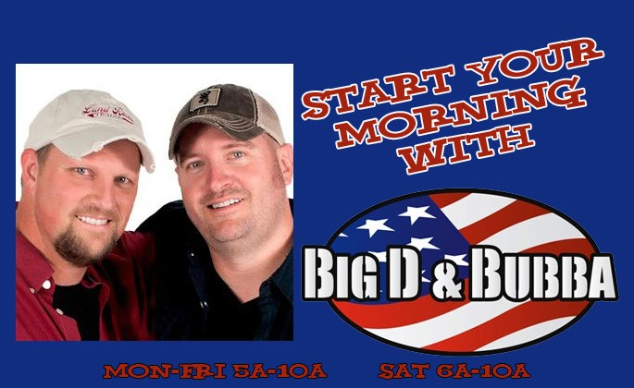



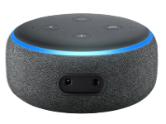





STREAMING ONLINE
www.1029bigcoutry.com
Mon-Fri 5a-10a, Sat. 6a-10a
Set it Up:
“Alexa, ENABLE W M K C SKILL”
“Alexa, ENABLE big country one oh two nine SKILL”
Then OPEN or LAUNCH & listen!
Listen on the app:
Steve C Mon-Sat 10-3pm
  Mon-Fri Noon-1pm - Take Out Tunes - All Request Lunch Hour
Greg Fletcher Mon-Fri 3-7pm
  Mon-Fri 3:50pm On The Horizon - The newest of the new -
  Mon-Fri 4:20 Laughter At 20 After - Comedy Break
  Mon-Fri 5-6pm All Request Drive at Five
Saturday 7p-Mid B-Dub Radio Saturday Night
Sunday 5-5:30am Issues & Programs
Sunday 6-8am Rise Up Country -
Sunday 8-11am Honky Tonkin with Tracy Lawerence Hosting
Sunday 8p-Midnight Top 30 Country Countdown with Bobby Bones
Connect on with us on our socials:
BIG Heart!
Official station for

Slide 19
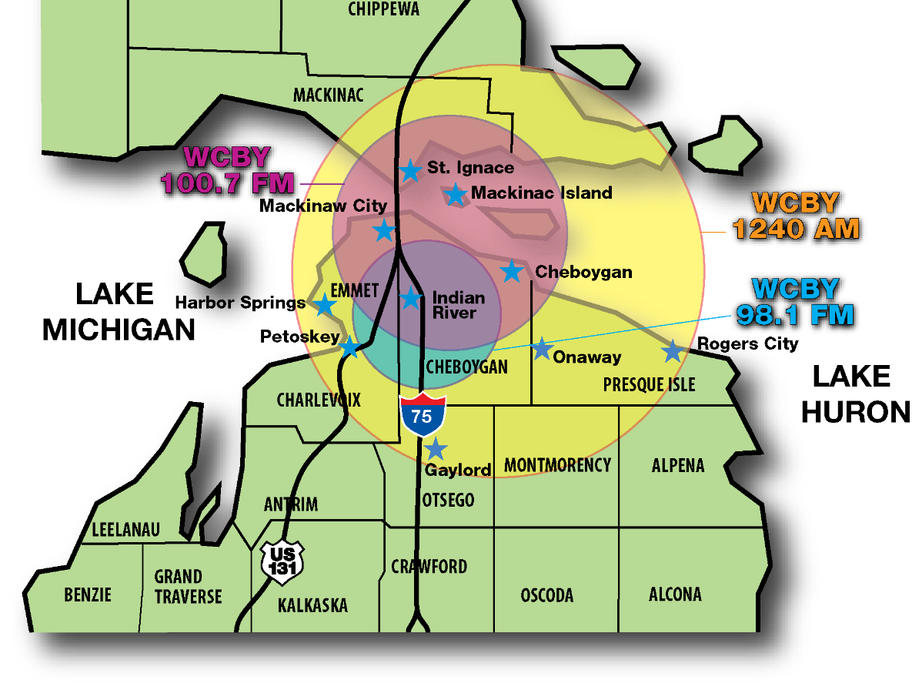

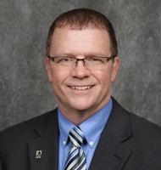
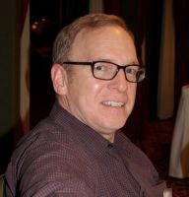











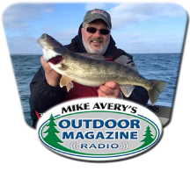
STREAMING ONLINE
www.bigcoutrygold.com
News & Sports with Mike Grisdale
Weather Forecasts by Tim O’Brien
Big Country Gold has over 1200 songs in our library.
Core of the music is 1980's country when the country music format was experiencing it's largest growth along with hits from the 70s and into the early 90’s and classic songs picked from the music vault.
Artists range from the well-known super-stars to the one-hit wonders and some of the popular cross-over artists and groups of the era.
WCBY enjoys being part of the community and helps promote local/regional non-profits and charity organizations and communities with announcements and information about their events and fund raisers on The Community Calendar.
WCBY features daily health care programs and an animal adoption/found pet report from the Cheboygan County Humane Society.
Mike Grisdale hosts "The Saturday Scoreboard" as part of the Saturday Noon News, The Saturday Scoreboard is a recap of local high school sports, collegiate and professional sports as well.
Sunday's we have 2 live church broadcasts - that serve a vital link to many who are homebound and with the pandemic they allow folks to stay at home and hear the services.
SAT 6A-9A

Slide 20
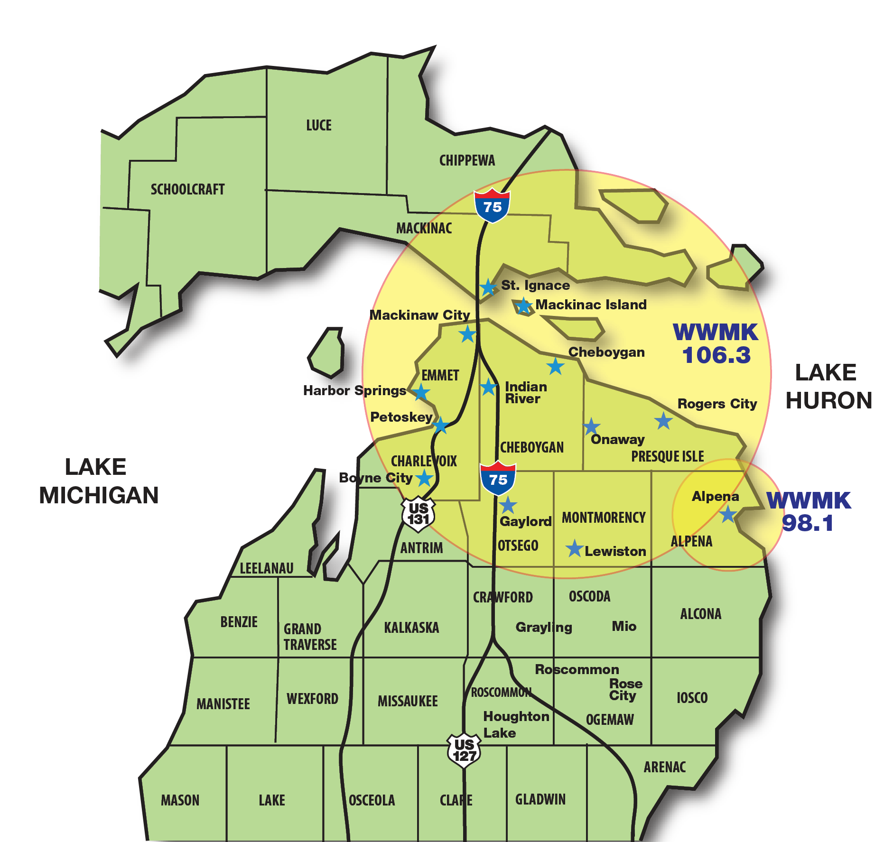









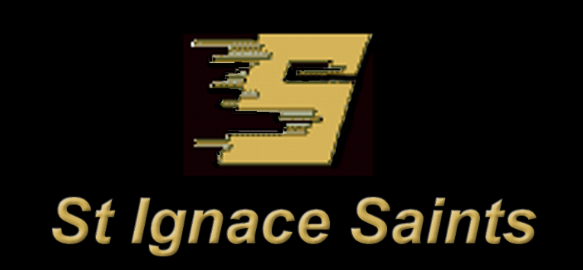
PETOSKEY,
CHARLEVOIX & MACKINAC STRAITS AREA
WWMK
106.3
STREAMING ONLINE
www.1063macfm.com
The MAC FM is targeted at the affluent 35+ listener who our advertisers need to reach and is custom designed to provide a perfect blend for at work listening, and to serve as the perfect back drop sound for any business in the area.
SMOOTH SAILING 106.3 MAC-FM
The Smooth Sailing MAC-FM is a unique blend of smooth hits of the 70’s and 80’s.
Smooth doesn’t just mean slow, but music you can relax to and enjoy whether you’re driving, listening at work or just sailing away.
HOME OF ST IGNACE SPORTS
LASALLE SAINTS Sports Coverage

Slide 21




Bay City
Cadillac
Clare
Freeland
Gaylord
Gladwin
Grayling
Harrison
Houghton Lake
Lake City
Midland
Mt. Pleasant
Roscommon
West Branch
Plus, everywhere in between!
CENTRAL MICHIGAN
Black Diamond Broadcasting Radio Stations are operated as major market stations, yet they are operated locally, serving local these communities;
We provide big personalities, top ranked station, exciting promotions, and world class technology which deliver advertising results.

Slide 22
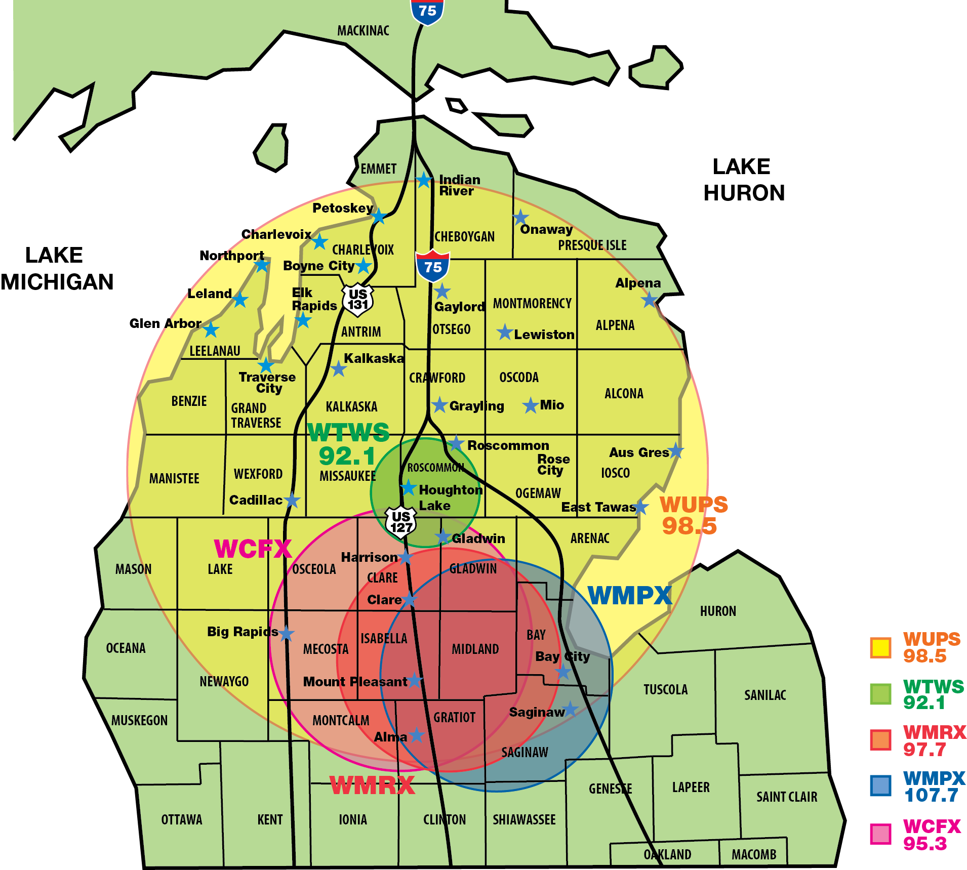


CENTRAL MICHIGAN
WUPS 98.5 The Classic Hits Station
Counties included in WUPS Coverage Area:
Alcona ; Antrim; Arenac; Bay; Clare; Crawford; Gladwin; Grand Traverse; Gratiot; Iosco; Isabella; Kalkaska; Lake; Mecosta; Midland; Missaukee; Montcalm; Montmorency; Newago; Ogemaw; Osceola; Oscoda; Otsego Roscommon and on line at www.wups.com .
WTWS 92.1 FM The Twister
Counties Included in WTWS Coverage Area: Clare; Crawford; Gladwin; Kalkaska; Missaukee; Ogemaw; Osceola; Roscommon on line at www.ilovethetwister.com
WMRX SUNNY 97.7
Counties included in WMRX Coverage Area:
Arenac; Bay; Clare; Gladwin; Gratiot; Isabella; Mecosta; Midland; Missaukee; Ogemaw; Osceola; Roscommon and on line at www.sunny977.com .
WMPX – SUNNY 107.7, 1490AM (100% simulcast of 97.7)
Counties Included in WMPX Coverage Area: Bay, Gratiot, Midland, on line at www.sunny977.com
WCFX – 95.3
Counties included in WCFX Coverage Area:
Bay; Clare; Gladwin; Gratiot; Isabella; Mecosta; Midland; Missaukee; Osceola; and on line at www.WCFX.com

Slide 23
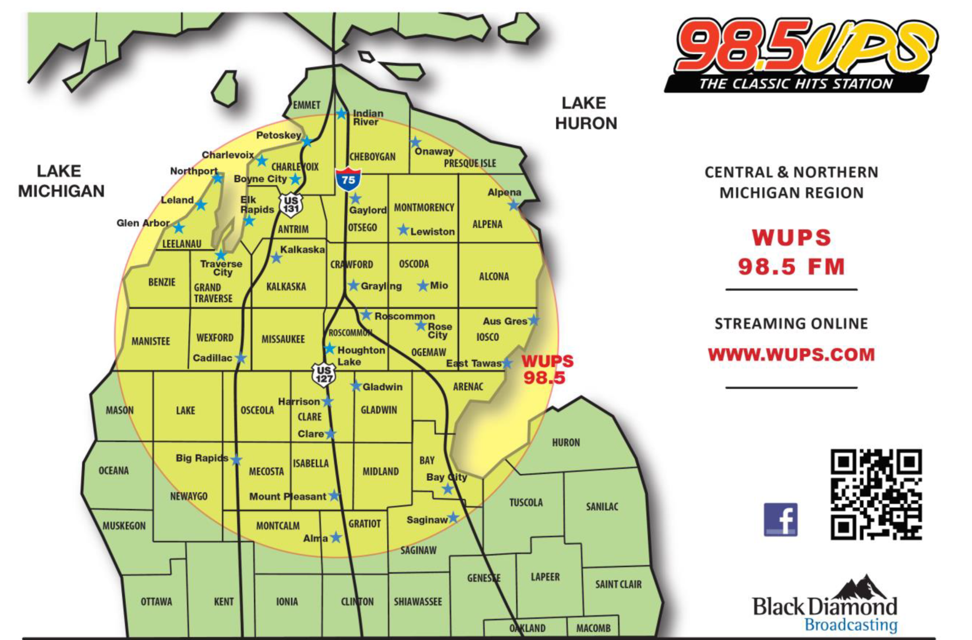

98.5 WUPS Classic Hits Stations is the LARGEST Land Mass Signal in Michigan
  Covering over 35 counties
  Every major corridor US131; US127 & I-75
  Bridge to Bridge – Coast to Coast
  WUPS is heard throughout Central and Northern Michigan
  Established, well known and admired on-air personalities – Steve, Tammy & Ted, joined by Mike Avery with the Outdoor Magazine Show
  Official Radio station of Tip-Up-Town USA & the AuSable River International Canoe Marathon
  98.5 WUPS is the flagship radio station for Central Michigan football and men’s basketball
98.5 WUPS Targets Adults 35-64
  Broad based appeal of Classic Hits is multi-generational
  55% Male / 45% Female audience
98.5 WUPS Builds Brand Awareness & Loyalty for your Business
  Consumers that listen to WUPS are affluent, educated, most own their homes and have established careers
98.5 WUPS Featured Core Artists:
  Aerosmith, Beatles, Boston, Doors, Eagles, Fleetwood Mac, Journey, John Mellencamp, Steve Miller Band, Tom Petty, Queen, Rolling Stones, Bob Seger, Van Halen, Who, Led Zeppelin, ZZ Top

Slide 24
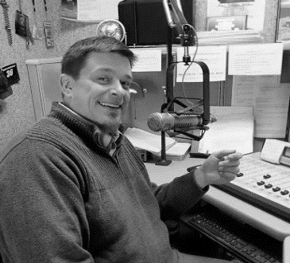
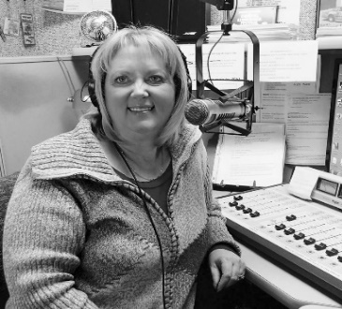
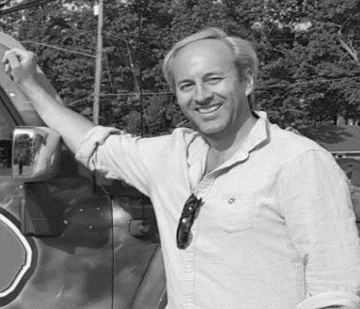



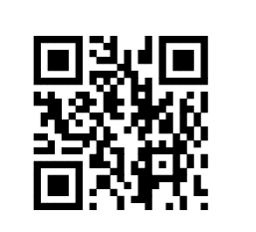




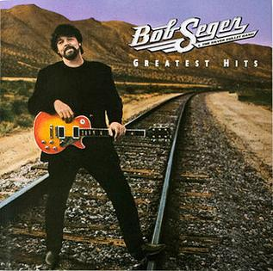

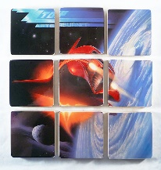
Established, well known on air personalities:
Steve in the Mornings 6a-10a
Mid-Day Mama, Tammy Thompson 10a-3p
Ted in the Afternoon 3p-7p
98.5 WUPS Builds Brand Awareness & Loyalty for your Business
Consumers that listen to WUPS are affluent, educated, most own their homes and have established careers.
Specialty Programming:
Mike Avery with the Outdoor Magazine.
CMU flagship station for Chip football and men’s basketball!
Fast Lane with NASCAR Steve
Community Involved:
Official radio station of Tip-Up-Town USA &
The AuSable River Canoe Marathon.
98.5 WUPS Featured Core Artist:
98.5 WUPS Targets Adults 35-64
• Broad based appeal of Classic Hits is multi-generational
• 55% Male/45% Female Audience
STREAMING ONLINE
www.wups.com

Slide 25
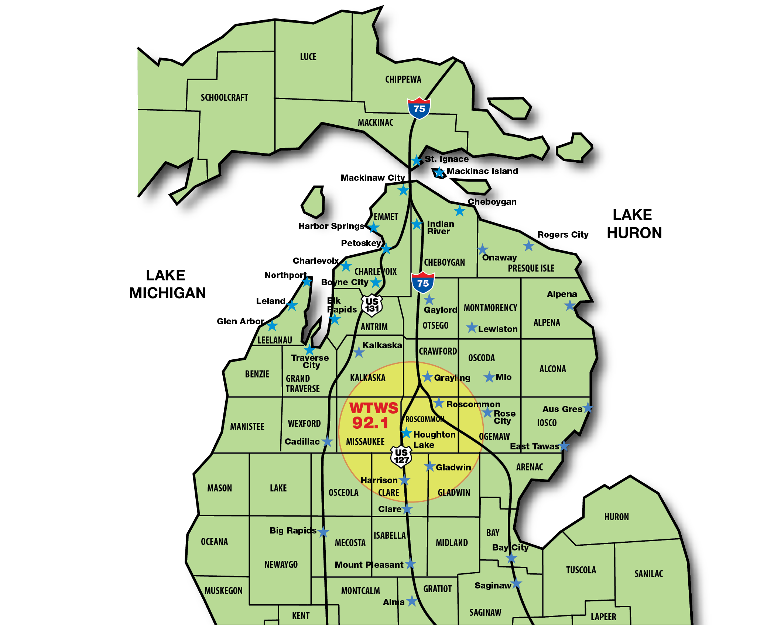










Houghton Lake
Harrison
Gladwin
Grayling
And more are getting swept away by
The Twister!
STREAMING ONLINE
www.ilovethetwister.com
92.1 The Twister Targets Adults 25-54
Multi Generational audience with America’s #1 choice of music – Country!
Affluent consumers that are loyal, educations, home owners, established professionals.
Listeners listen for long periods of time which makes your advertising dollars stretch farther.
Involved with our hometown high school football; Houghton Lakes Bobcats
Mike Avery’s Outdoor Magazine
Country lifestyle at the core!
92.1 The Twister Featured Core Artists:

Slide 26

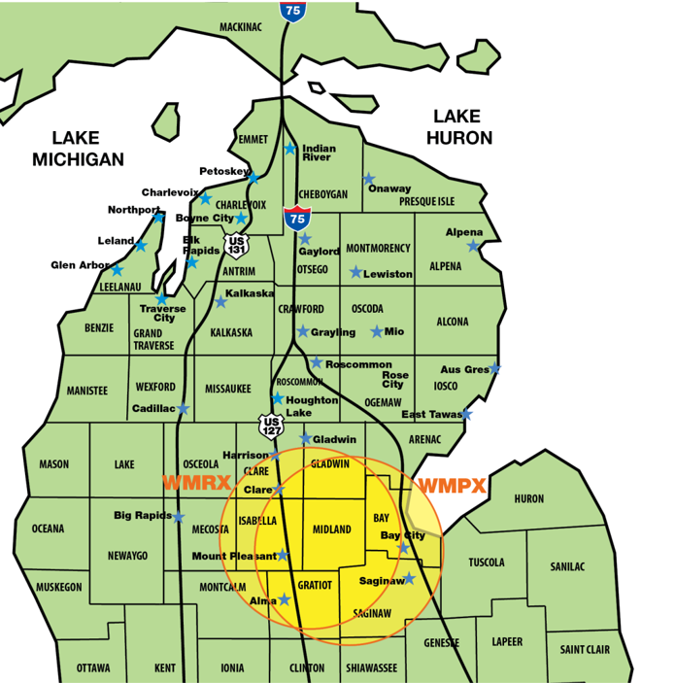









Mid Michigan's Fresh New Sunny 97-7 & 100% Simulcast on 107.7!
Playing Mid Michigan's Favorite Hits.
STREAMING ONLINE
www.sunny977fm.com
Sunny 97 7 Targets Adults 35-64
Great Songs from the 80's, 90's and more!
Adult female demographic audience puts advertisers in front of the primary purchase decision makers.
With a focus on the Midland, Mount Pleasant, Gladwin, Clare areas, Sunny is the best choice for local businesses to reach local consumers as it delivers local information that is focused on these communities. Local news, and community events are talked about almost every hour by our local talent;
100% simulcast on 107.7 and 1470AM sending a stronger signal into downtown Midland.
Sunny 97 7 Core Artist:

Slide 27
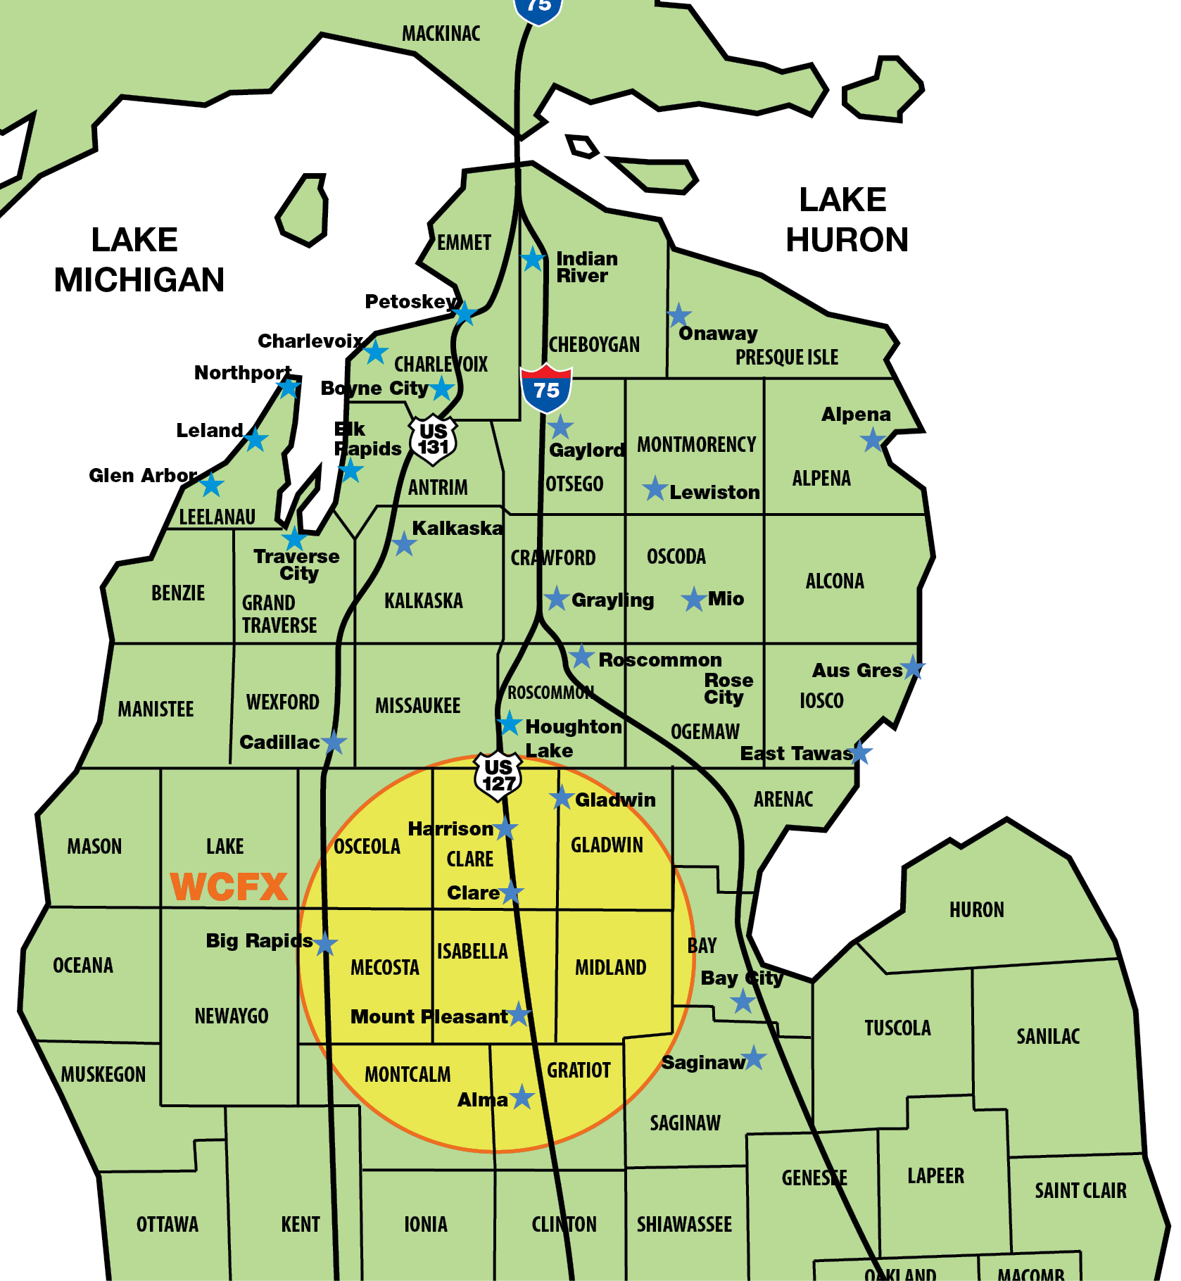







CLARE, GLADWIN, GRATIOT, ISABELLA, MECOSTA, MIDLAND & MONTCALM COUNTIES
WCFX 95.3 FM
http://www.wcfx.com
Today' Hits, 95-3 CFX – Covering over 8 Mid-Michigan Counties. 65% female audience, between 18 & 49 years old.
The average listener age is 32 & our listeners are active with growing families & have a proven desire for all of the products and services families need.
We do much more than play great music & inform.
For years, CFX has been involved heavily involved with business & civic communities. While business looks to us to deliver an effective message to their prospective customers, non-profit organizations come to us for support & to inform our listeners of the many events that take place within the area.
We are LIVE & LOCAL
Anchored by over 30-year Mt Pleasant Radio Veterans Kent Bergstrom& Rob Ryan, the morning show "The Breakfast Flakes" is a staple in Mid-Michigan For Fun, Music & Information. 2p-6p you host is Angie Evans, community involved and invested WCFX is your local Mt. Pleasant station!

Slide 28



WHO’S LISTENING TO WCFX?
WHERE DO WCFX LISTNERS LIVE?
60% of this listener database were from Isabella County.
The other 40% were from the neighboring counties of Clare, Gratiot, Midland, Gladwin, Montcalm, Mecosta, Bay, Osceola & Saginaw.
The audience composition information shown here is based on active engagement database of 3500 listeners collected at WCFX.

Slide 29
Black Diamond Broadcasting can help you realize success with a cost effective, broad reaching, results oriented proven media - Radio Campaign and Promotional Opportunities! On-air and On-site!
Over 95% of adults listen to Local Radio everyday!
Nothing builds FIRST IN MIND awareness and brand building opportunities better than LOCAL RADIO!
Black Diamond Digital Solutions can put your message where today’s consumers are through technology. On their desk-top, tablet or phone we can help you reach your customer where they are!
www.MichiganForHire.org is a recruitment resource for Northern Michigan businesses looking for employees in Northern Michigan.

Slide 30


Display Advertising on the internet and beyond! Beyond our “Owned & Operated” digital assets!
Ask how we can help you have a presence where consumers are spending their time!
NOT O&O digital!
Product: | Description:
Live Chat | Get more leads by engaging your prospects with a chat box and text-to-chat on your website.
Display | Display ads go across all devices, appearing on websites or apps, using targeting strategies including Retargeting, Behavioral Targeting, Artificial Intelligence, and Keyword Targeting.
Online Audio | Audio ads served to targeted online listeners who are consuming audio content across all types of devices, using the targeting strategies of Behavioral Targeting and Artificial Intelligence.
Facebook and Instagram Targeting | Targeting people across all devices with display or video ad on Facebook and Instagram in their News Feed, on Facebook Audience Network, Messenger, Facebook Instant Articles, Stories, Marketplace, or a custom audience of your database of emails or addresses and Lookalike audience.
Native | Native display and video ads go across all devices and match the look, feel and context of the website or app where they are seen, using targeting strategies including Retargeting, Behavioral Targeting, Artificial Intelligence, and Keyword Targeting, or a custom audience of your list of emails and Lookalike audience.
Mobile Conquesting | Reaching people with display and video ads on their mobile devices using targeting strategies including Behavioral, Geo-Fencing, Geo-Retargeting, Geo-Retargeting Lookalike, and Weather Triggers. Or a custom audience of your database of addresses. On-Site Visit Tracking to your business is available.
Video Targeting | Video ads go across all devices, appearing on websites or apps, using targeting strategies including Retargeting, Behavioral Targeting, Artificial Intelligence, and Keyword Targeting. Options include YouTube and Over-The-Top (OTT) ads (Connected TVs).
Household IP Targeting | Matching IP addresses to your list of names and street addresses and showing your display, native or video ads only to those people, across all devices.
SEO & Rep. Management | Improving and promoting a website to increase the number of visitors the site receives from search engines.
Pay-Per-Click | Showing your text ads on the Google Search Engine Results Page when a user searches keywords related to your business, across all devices.
Geo-Framing | Going back in time to previous events where we have captured people’s mobile Device ID’s, mapping to their homes, and showing them display ads now.
Amazon Premium | Using Amazon targeting data to reach people with your display, video, or OTT ads on Amazon.com, Amazon owned properties and thousands of other websites and apps Amazon has partnered with, across all devices (display only on Amazon.com)
Social Mirror Ads | Social Mirror ads look like your social media display or video posts but appear on other websites and apps, linking back to the social media platform and your website, and run across all devices using our targeting strategies.

Slide 31
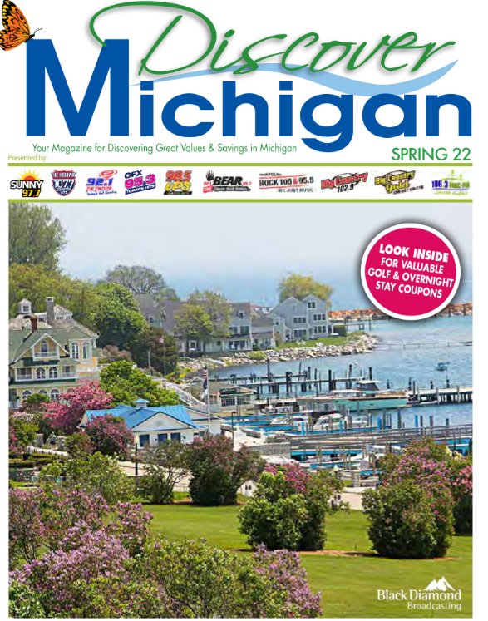
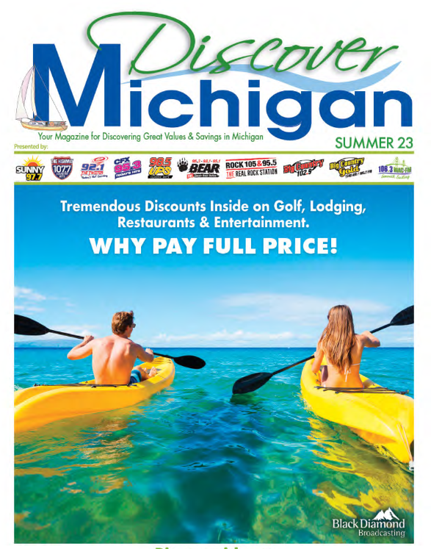
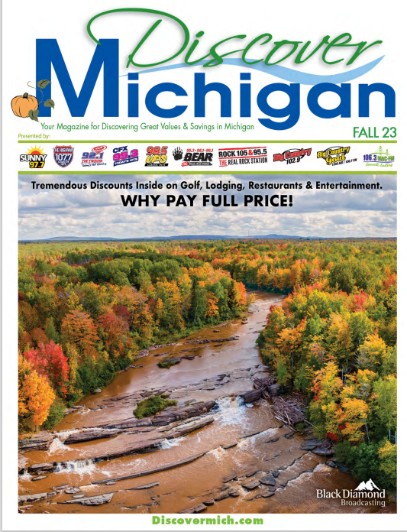


Get your destination
at the top of travelers’ plans!
Over16,000 Printed + Digital
Discover Michigan reaches audiences through audio messages on traditional radio stations, audio streams and mobile apps, in printed and digital publications, social media and website outlets!
You can too!
DETAILS:
Inserted into the Clare, Gladwin & Mt. Pleasant newspapers.
The rest are placed in local businesses’ lobbies and in heavy traffic locations in Midland, Saginaw, Bay City, Mt. Pleasant, West Branch, Tawas, Gladwin, Beaverton, Harrison, Clare, Sanford, Coleman, Auburn, Freeland, Alma, Boyne City, East Jordan, Petoskey, Alanson, Gaylord, Traverse City and surrounding areas.
Copies are also available at the “Michigan Welcome Centers” and online!
OFFER COUPONS ON YOUR PRINT AD

Slide 32

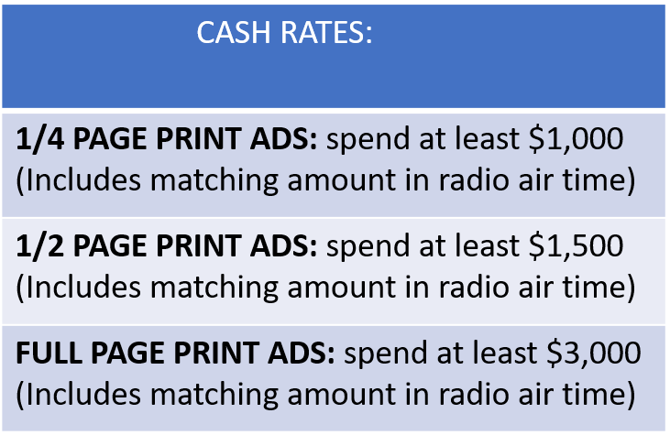
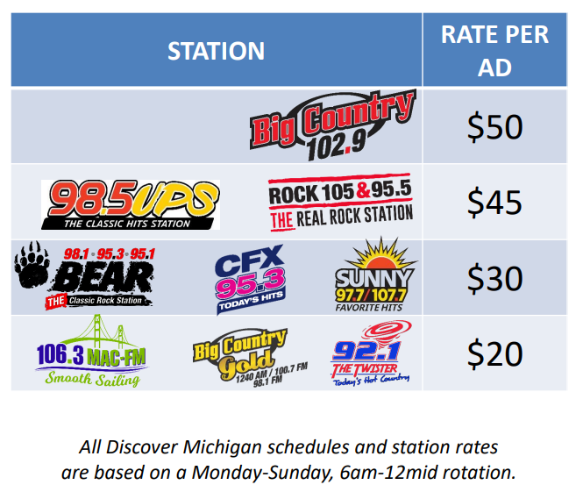
Spring Issue sent out late April, Summer Issue sent out early June, Fall Issue sent out early Sept, Winter Issue sent out early Dec
Discover Michigan magazine is published four times per year and is available online at
discovermich.com
Printed copies are placed in newspaper circulation in Clare, Gladwin, and Mt. Pleasant. The remainder of copies are in advertisers’ lobbies and in heavy traffic locations throughout the state. Copies are additionally available at Michigan “Welcome Centers”.
Main Office for
Discover Michigan Magazine
6800 Eastman Ave, Suite E564
Midland, MI 48642
(989)264-0110
Ad is due 30 days prior to publication date.
Size to Reserve: ____________ for editions: ______________________

Slide 33
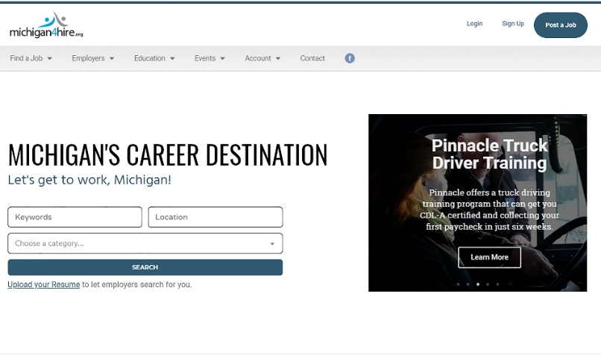
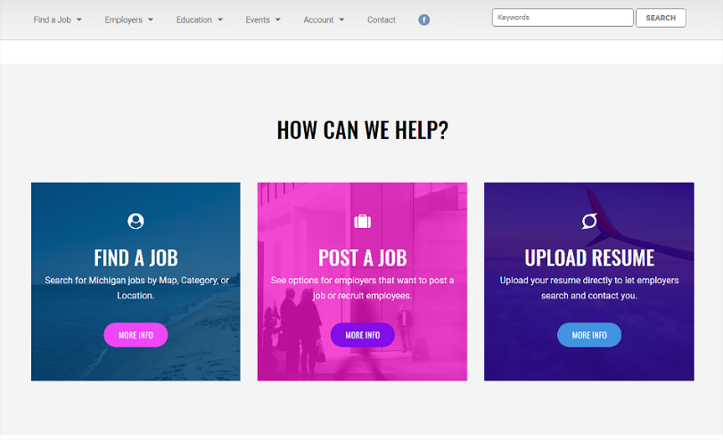
Providing a recruitment program to central & northern Michigan combining the power of Black Diamond’s audio mediums with Michigan For Hire to create a powerful recruitment and employee/employer matching program.
info@michiganforhire.org
Get started by going on-line to www.michiganforhire.org
Sign-up for the level that makes sense for you!

Slide 34

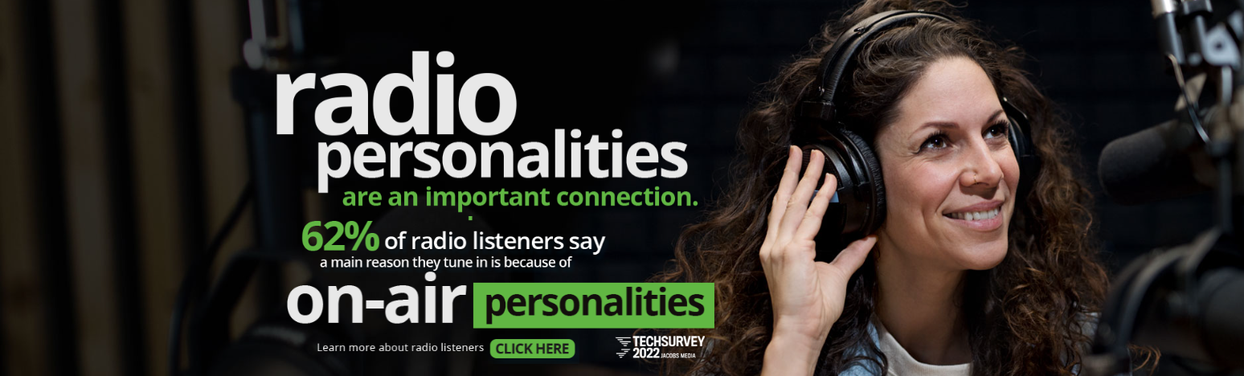
There have been studies that prove radio's ability to complement other media and drive brand awareness, as well as increase return-on-ad spend. Additionally, as today's advertisers and agencies begin to focus on attribution, radio can now quantify its impact on campaigns. Various organizations can now pinpoint shifts in behavior with digital technology.
As the top source for music discovery and audio entertainment, radio has a dominant role among listeners of all generations and age groups. Radio and the personalities on those stations are companions, something that keeps the listener company, elevates their mood, informs them and makes them think and laugh.
SOURCE: 2021 Radio Advertising Bureau

Slide 35

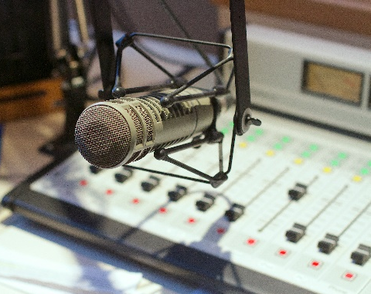

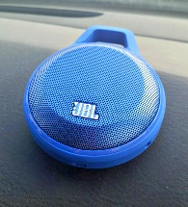
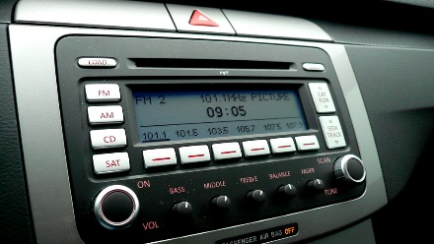

Radio remains relevant in today's world of time-starved consumers. As the original mobile and social medium, it provides programming content meeting the entertainment needs of people according to their demography, geography, ethnography, etc., via its thousands of commercial radio stations, streams, multicasts and podcasts.
Radio is ubiquitous, reaching consumers on-air, online, on-site and on demand whether they are at home, at work or in their car. It is a passive medium allowing consumers to multi-task and listen while they work or play in today's world.
It is a reach medium, delivering messages 24/7 to consumers personally, one-on-one, in an attentive environment. It provides information as it reaches consumers closest to their time of purchase, as they drive to or from work, or even during a lunch break. When used synergistically with other media, it increases brand awareness, brand recall, and an advertiser's ROI. In various studies, it has also proven to increase website visitation and purchase likelihood.
SOURCE: 2021 Radio Advertising Bureau
Radio is resilient. Its accessibility continues to expand with technology. Innovations in this same technology are both enhancing and expanding radio's ability to provide content to listeners whenever, wherever they want it on-air, online, or on demand.

Slide 36
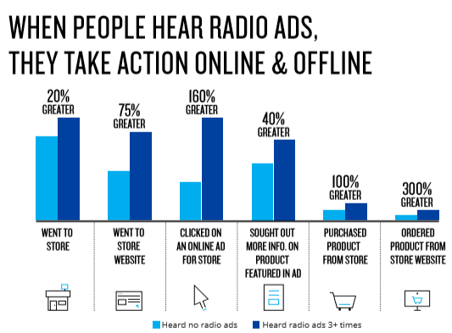


THOSE WHO HEARD THE RADIO ADS WERE FAR MORE LIKELY TO GO ONLINE TO FIND AND MAKE A PURCHASE FROM THE ADVERTISER.
A major retailer wanted to know the impact Radio advertising is having on shopping and purchase behavior. Nielsen conducted a campaign effect study where people were asked “Which of the following actions, if any, did you take after hearing the store ads?” The responses were separated between those who did not recall hearing a radio (in light blue) and those who recall at least 3 radio ads from this retailers (in dark blue). Store visits were 20% higher among those who heard the radio ads. Visits to the retailer’s website were 75% greater, click-through rates soared 160% for the retailer’s online ads and product searches jumped 40% higher amongst those exposed to the radio ads. Most importantly, radio advertising increased sales instore and online for this retailers. This study not only confirms that radio not only drives consumers to retails locations but it also enhanced e-commerce efforts for brick-and-mortar businesses.
+

